Slide 1
MRI Image Hippocampus Segmentation
Wayne Kuo

Slide 2
Project Overall Structure
Goal
Classify each image pixels as either Hippocampus class (Label: 1) or not Hippocampus class (Label: 0)
Data set description
Data set preprocessing
Building models.
Visualize performance metrices.

Slide 3
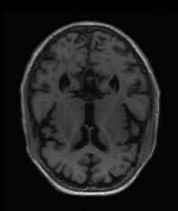
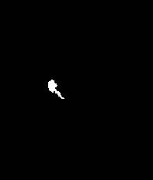
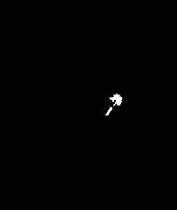
Data Set Description
Original
The data set contains 135 patient’s MRI images and each patient has their own 189 MRI images as well. Each images have a size of 233 * 197 * 3 (3 is the color)
For the label images there are 2 MRI images labeling left and right side of hippocampus pixels.
Total number of original (Feature) MRI images: 25515
35 Patient’s image is used as testing data.
L Label
R Label

Slide 4
Data Preprocessing.
Resizing the image size to 1/3 of its original value to speed up computation.
Rescale the pixels’ RGB to grayscale and normalize the original (feature) image pixels value.
Label image pixels’ values are set to 1 for hippocampus pixel and 0 for non hippocampus.

Slide 5
Building Models
The main model we use is ConV2D neural network.
Due to the imbalance nature of each pixels’ class, we will use Binary Cross Entropy for all our models’ loss function.
5 Models
Base Model (1 Input/3 Conv2D/1 Output)
Drop Out Model (1 Input/1 Conv2D/1 Drop Out/2 Conv2D/1 Output)
Edge Model (1 Edge Filter Input/3 Conv2D/1 Output)
Max Pool Model (1 Input/3 Conv2D/1 Max Pool/1 Output)
Edge/Sharpen Model (1 Edge Filter Input/1 Sharpen Input/3 Conv2D/1 Output)

Slide 6
Evaluate Model Performance
We will use the following metrices:
F1-score
Matthews Correlation Coefficient (MCC)
Confusion matrix
ROC Cruve

Slide 7
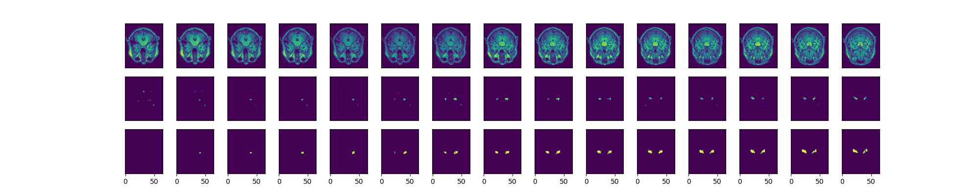
Output visualization (Base Model)
F1-Score = 0.40148
MCC = 0.40475
Confusion Matrix
Actual Values
 | Positive | Negative
Positive | 9735 | 17789
Negative | 11236 | 3212337
Predict Values

Slide 8
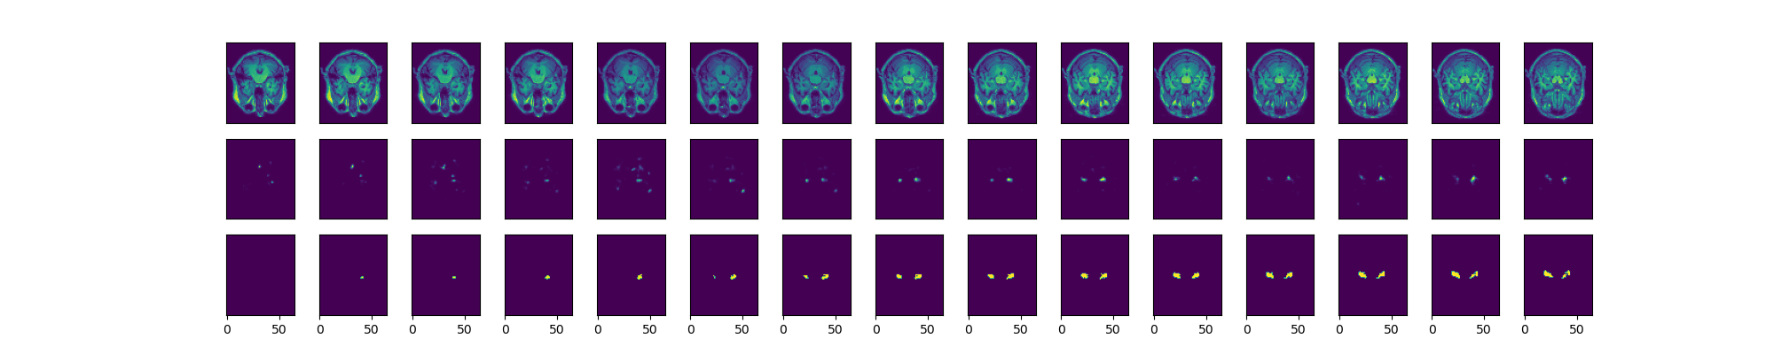
Output visualization (Drop Out Model)
F1-Score = 0.35248
MCC = 0.36809
Confusion Matrix
Actual Values
 | Positive | Negative
Positive | 10452 | 27881
Negative | 10519 | 32113278
Predict Values

Slide 9

Output visualization (Max Pool Model)
F1-Score =0.41361
MCC = 0.41729
Confusion Matrix
Actual Values
 | Positive | Negative
Positive | 10087 | 17717
Negative | 10884 | 32123442
Predict Values

Slide 10

Output visualization (Edge Filter Model)
F1-Score = 0.298532
MCC = 0.31764
Confusion Matrix
Actual Values
 | Positive | Negative
Positive | 4658 | 5577
Negative | 16313 | 32135582
Predict Values

Slide 11

Output visualization (Edge/Sharpen Model)
F1-Score = 0
MCC = -1.85708
Confusion Matrix
Actual Values
 | Positive | Negative
Positive | 0 | 17
Negative | 20971 | 32141142
Predict Values

Slide 12
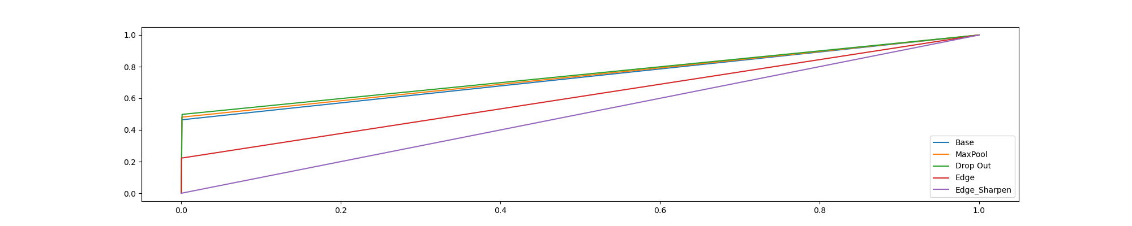
ROC Curve

Slide 13
Reference
https://www.kaggle.com/code/brsdincer/mri-hippocampus-alzheimer-segmentation-all-process/data
https://www.tensorflow.org/tutorials/images/segmentation
https://www.kite.com/blog/python/image-segmentation-tutorial/

